Slide 1
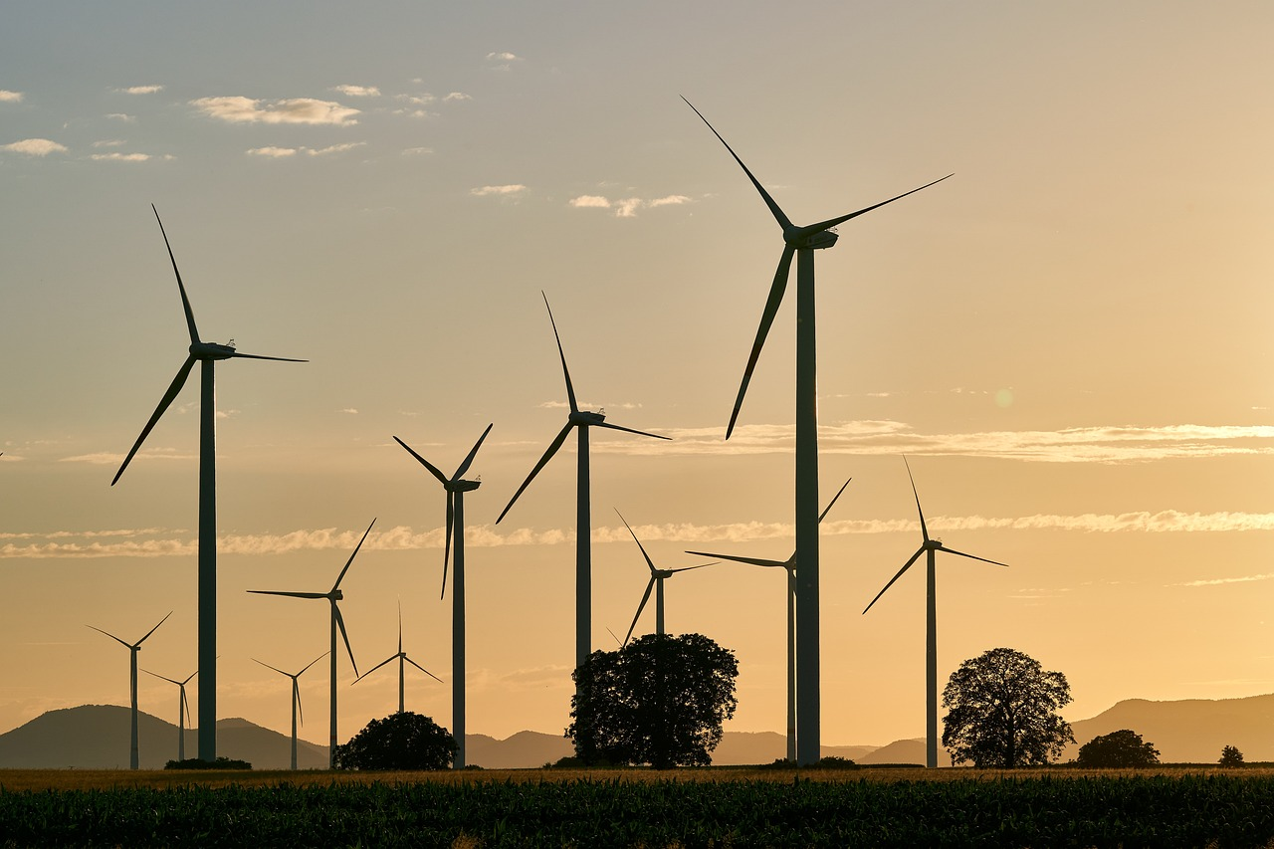
SAVING ELECTRIC
ELECTRICITY SAVING PLAN: 4WEEKS
SAVING IN ELECTRICITY, LIGHT IN THE FUTURE

Slide 2
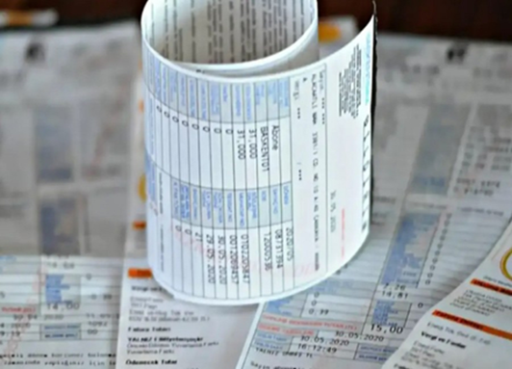
Week 1: Creating Electricity Consumption Awareness
Objective: To raise awareness among family members about the importance of electricity consumption and saving.
What to do:
1. Examine the electricity bills at home. Take note of the number on the electricity meter.
2. Create a list of devices that consume electricity.
3. Determine which devices consume more energy.

Slide 3
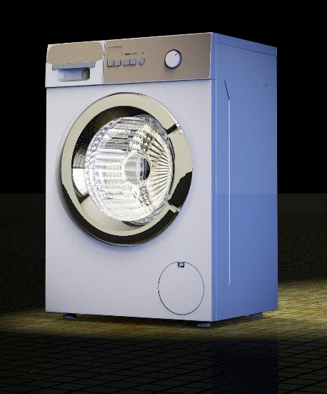
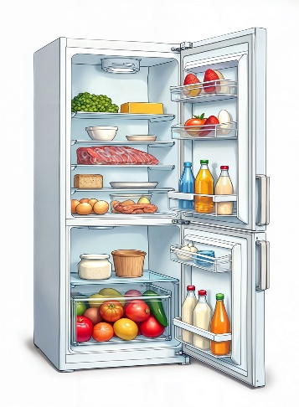
Electricity Consuming Devices | Duration of daily use | Energy consumption(KWh)
television | 4 | 0.8
fridge | 24 | 1.2
washing machine | 1 | 0.5

Slide 4
Week 2: Preventing Unnecessary Electricity Use
Objective: To prevent unnecessary energy consumption of unused devices.
What to do:
1. Switch off lights in unused rooms.
2. Do not leave electrical appliances in stand-by mode.
3. Identify devices that need to be unplugged.

Slide 5
Same Week Use of Energy Efficient Devices
Objective: To learn about and use energy-saving devices.
What to do:
1. Check the energy ratings of the appliances in your home.
2. Use energy-saving light bulbs and energy-efficient appliances.

Slide 6
Week 3: Changing Electricity Use Habits
Objective: To develop energy saving habits in daily life.
What to do:
1. Use electrical appliances less during the day (e.g. run the washing machine at night).
2. Supplement lighting with natural light.
3. Switch off unnecessary appliances completely.

Slide 7
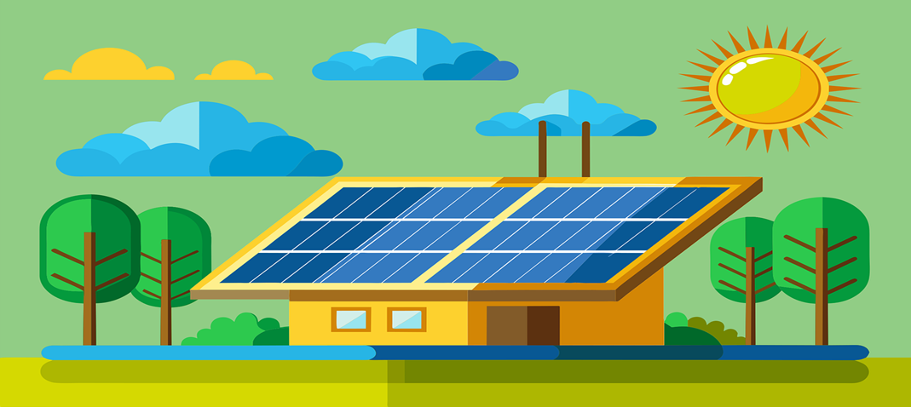
Same Week Awareness about Renewable Energy Sources
Objective: To promote the use of solar energy and other renewable energy sources.
What to do:
1. Learn about solar energy panels.
2. Learn about the environmental impact of renewable energy sources.

Slide 8
Week 4: Sharing the Results
Objective: To share the benefits of saving electricity with your neighbourhood.
What to do:
1. After the awareness raising with electricity consumption, note the number on the electricity meter and compare the first week with the last week.
2. Discuss the results with family members and friends.
3. Raise awareness by emphasising the savings on the bill.

Slide 9
WITH ENERGY SAVING WE HAVE A BETTER FUTURE IN OUR HANDS

